Slide 1
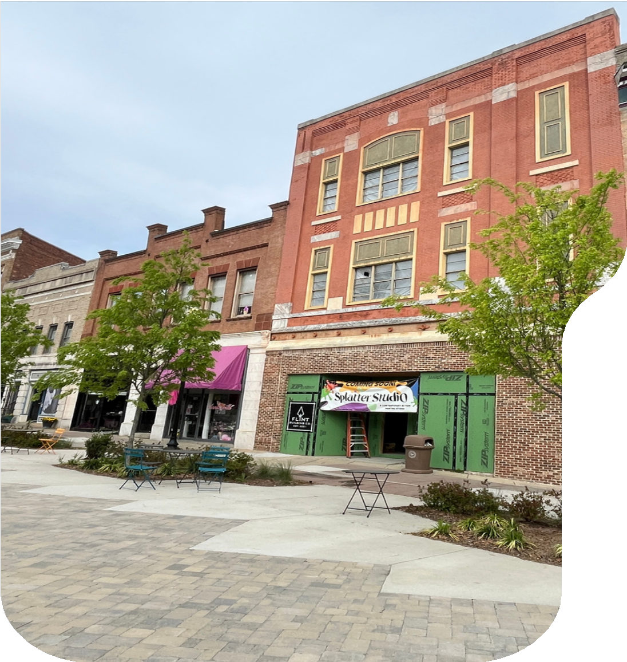
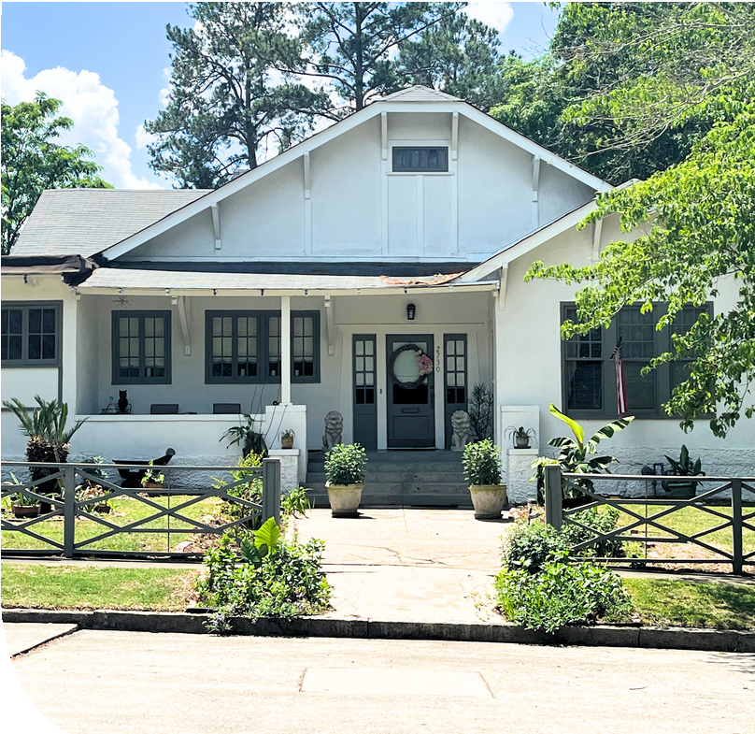
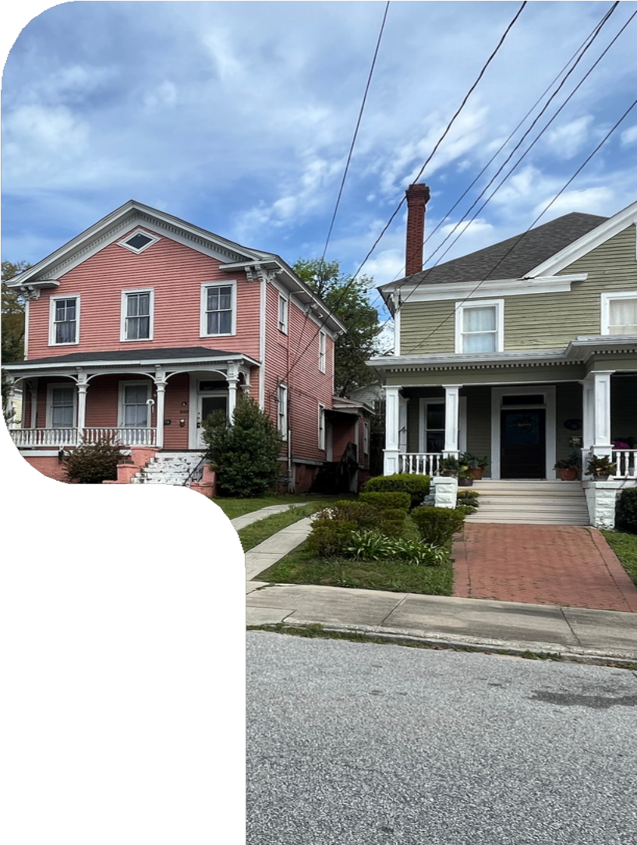
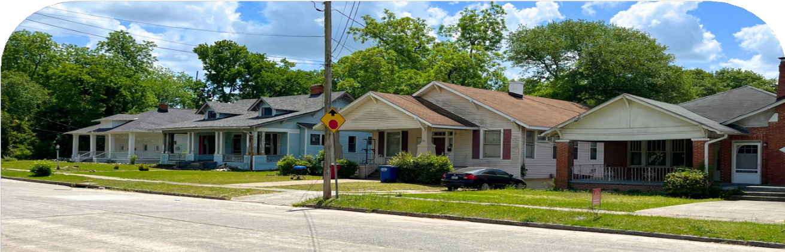
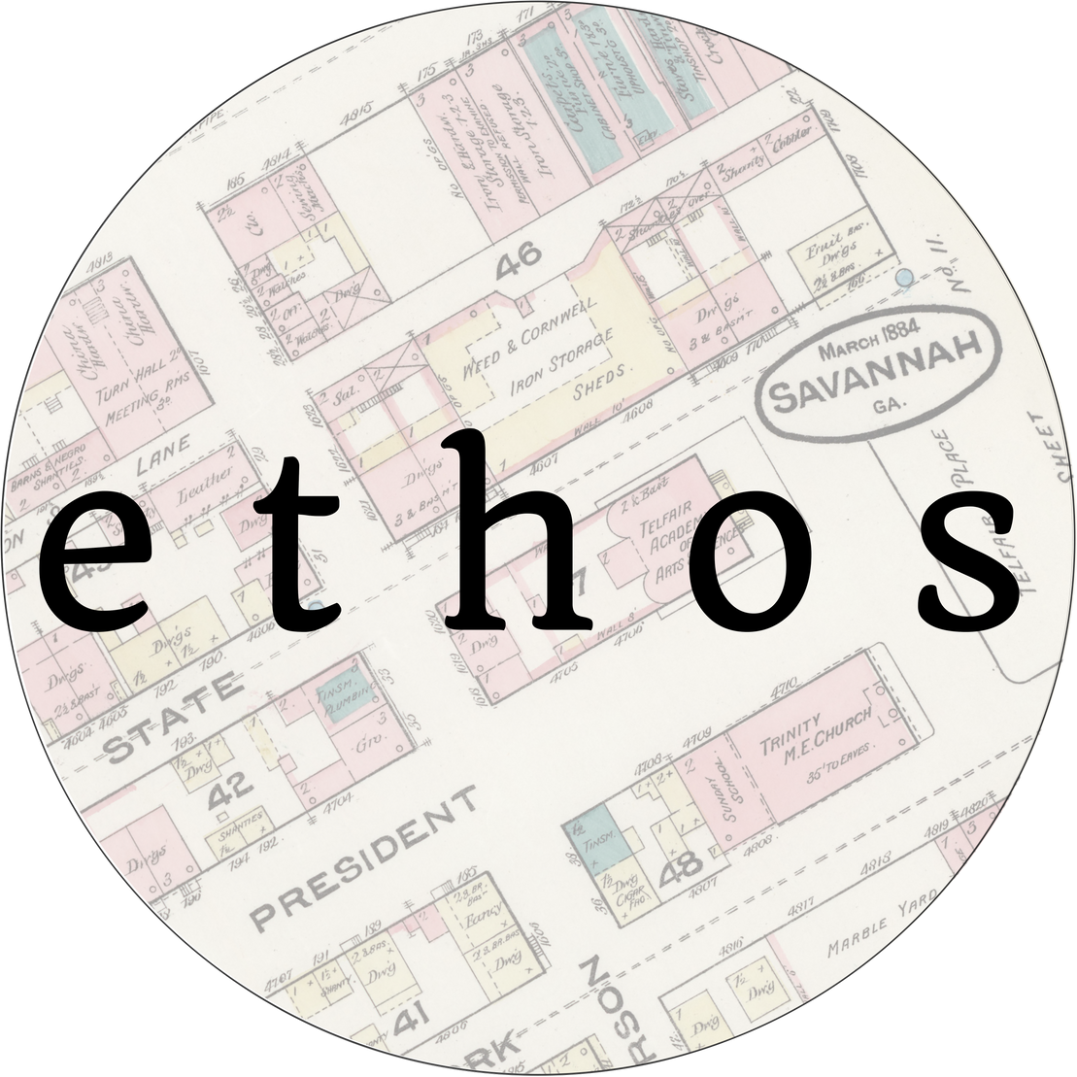
MACON-BIBB DESIGN GUIDELINES
Creating Design Guidelines for Macon-Bibb’s Historic Districts
June 20, 2024

Slide 2
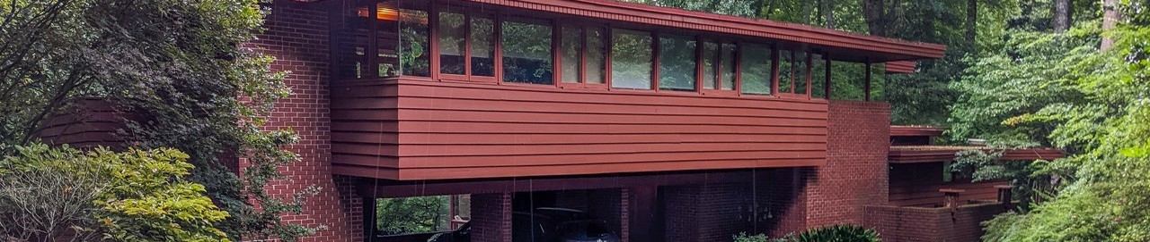
About
ETHOS PRESERVATION
Ethos Preservation is a Savannah-based firm offering a wide range of preservation planning services with a focus on project consulting in historic districts, to include municipal preservation planning, historic tax credit consulting, National Register nomination research and composition, grant writing, and more.
To learn more visit: www.ethospreservation.com.

Slide 3
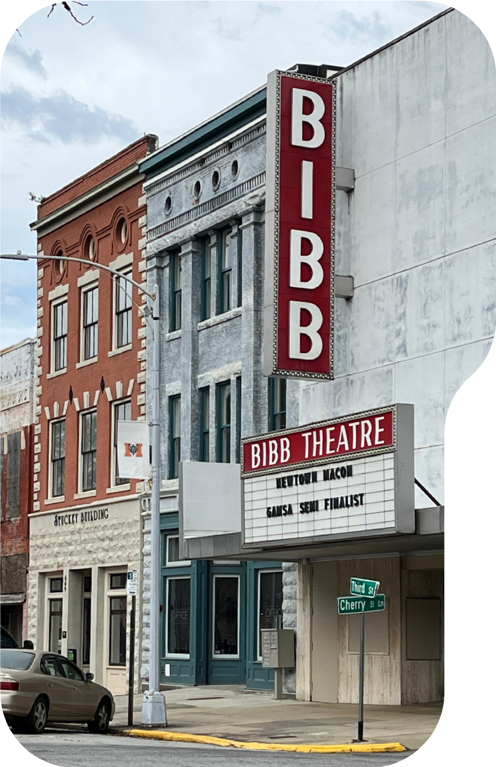
Project Overview
Existing guidelines created in 1986 Need updating
new technology materials
clearly defined process
Contributing/non-contributing maps updated Periods of significance updated for each district

Slide 4

History
The Process
Survey
Public Input
Prepare Draft 1 Public Input Prepare Draft 2 Public Input Prepare Final Draft
Adoption of Design Guidelines
First Quarter of 2025

Slide 5
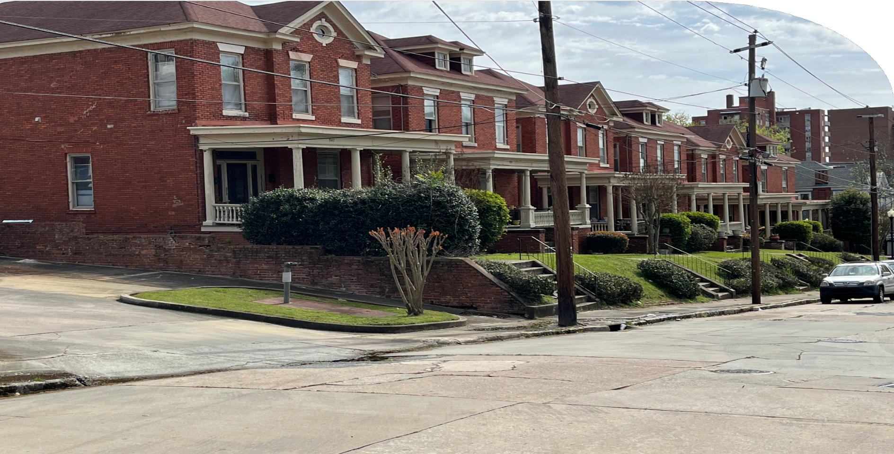
Local Historic Districts
01
Protect historic resources
Prevents demolition, inappropriate alterations
02
Ensure compatible new design
Preserving the past while embracing the future
03
Certificate of Appropriateness Required
All changes visible from a public ROW

Slide 6
INTOWN
Historic Districts Included
CENTRAL BUSINESS DISTRICT
VINEVILLE
CHEROKEE HEIGHTS

Slide 7
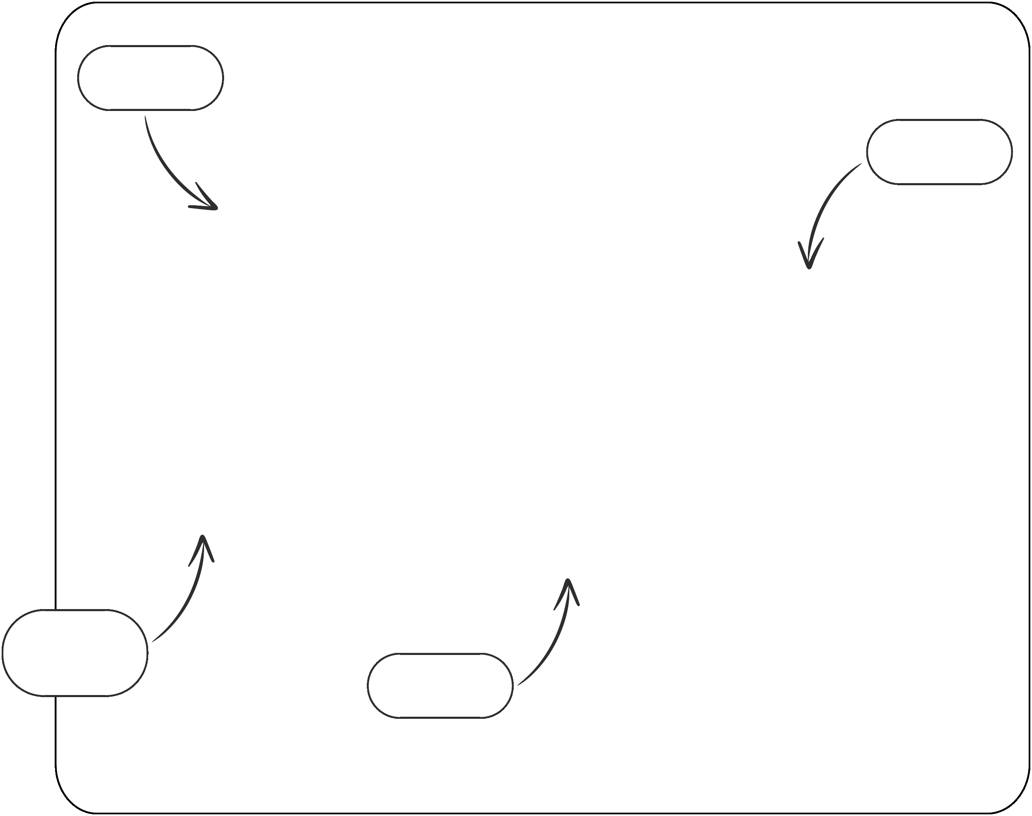
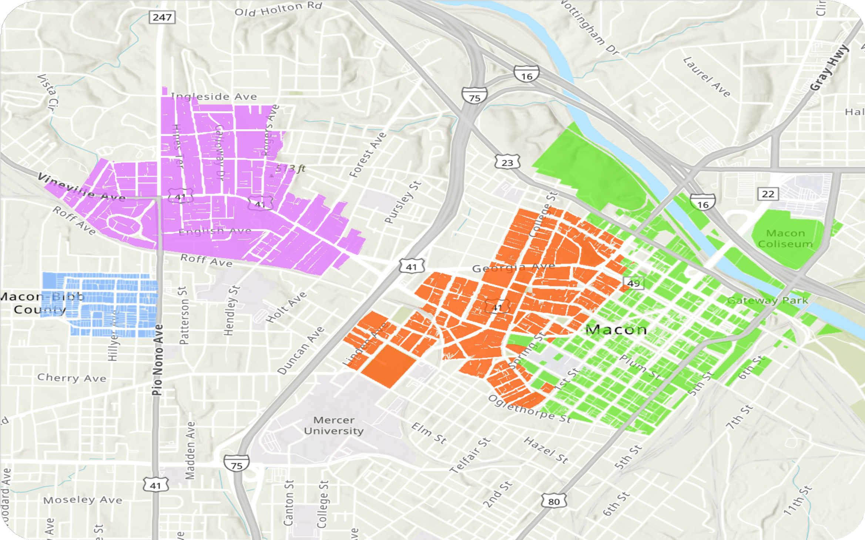
Vineville
CBD
Historic Districts
Cherokee
Heights
Intown

Slide 8
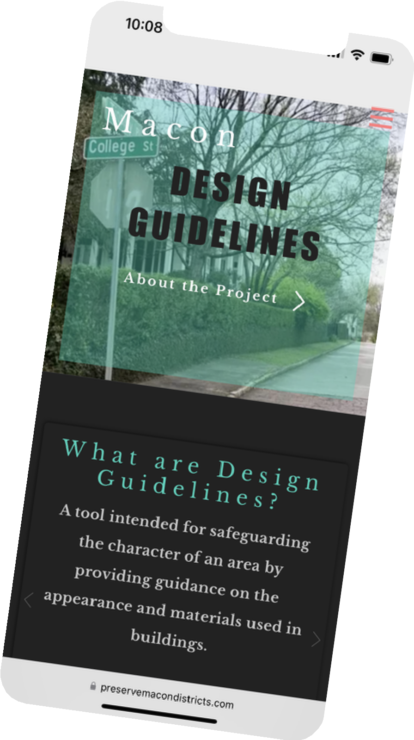


Survey Progress
As of June 19...
47 responses
97.8% Macon residents
71.7% Historic district residents 33% Vineville residents
84.8% Very important to save historic buildings
91.3% Very or somewhat important for new buildings to fit in
93.8% Very or somewhat concerned with demolition by neglect
WWW. PRESERVEMACONDISTRICTS. COM

Slide 9
Stay in Touch
Email
ellen@ethospreservation.com
Website
www.preservemacondistricts.com
Call us
912-844-2703

Slide 10
We want to hear from you!
Write a note on the boards!
Take the survey!
Tell us today (or email or phone)!

